Slide 1
Sociālā atbalsta tīkls senioriem SOCIĀLĀS AKTIVITĀTeS SENIORIEM

Slide 2
Sociālā atbalsta nozīmīgums
Pašīstenošanās
Maslova vajadzību piramīda
vēlme sasniegt maksimālos rezultātus
Cieņa
sociālā atzinība , izturība, brīvība
Piederības apziņa
ģimene, draudzība, grupas atbalsts, mīlestība, komunikācija
Drošība
aizsardzība, kārtība un tiesības, drošība, darbs, resursi
Fizioloģiskās vajadzības
gaiss, ūdens, miegs, barība, siltums, veselība, dzīves telpa, seksualitāte

Slide 3
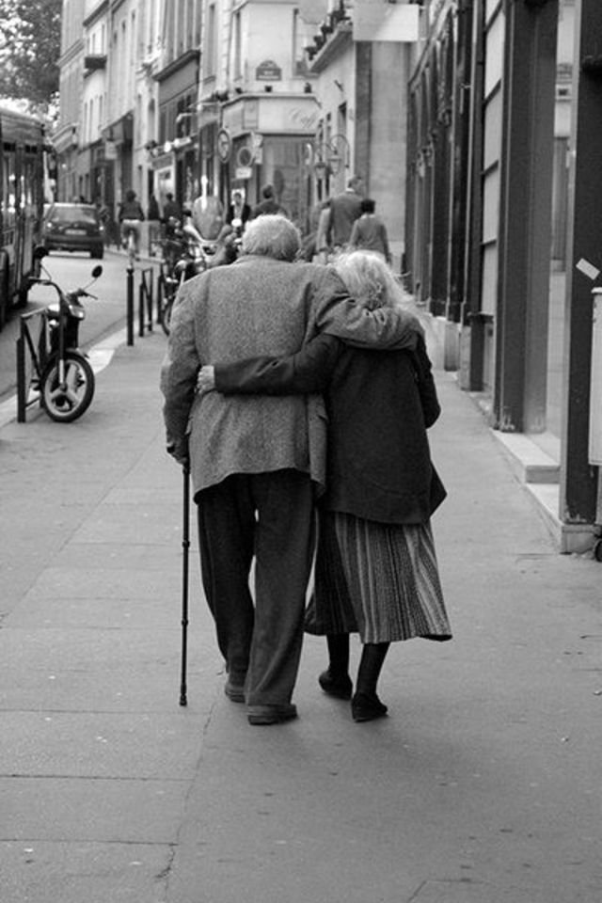
vajadzība būt attiecībās ar citiem cilvēkiem
Vajadzība pēc tuvām attiecībām ir ļoti aktuāla agrīnajā bērnībā, kad attiecības ar otru ir drošības un izdzīvošanas garants
Pieaudzis cilvēks ir daudz neatkarīgāks un spējīgāks par bērnu, bet tuvas un atbalstošas attiecības ar citiem cilvēkiem ir vienmēr svarīgas
Notes:
We know who we are only in relation to other people, from others we are reflected back and see ourselves.
Our mental health and personal well being are tied up in the quality of our personal relationships. The more closely we are connected to the people we love, the happier we feel and the more personal satisfaction we have in our lives. Most people rate moments of connection and shared enjoyment with their loved ones as their most important life experiences. These important relationships not only include family and personal friends but also the wider groups and communities we belong to. Forming connections and a sense of community with work colleagues, neighbours and the various groups that make up our identity (such as sports, hobbies, religious and community groups), all contribute to our well-being.
Forming a sense of belonging with other people around a shared mission or identity is a major contributor to our sense of personal meaning in life. Our personal resilience is interwoven into resilience of the communities to which we belong. It is from the web of our relationships and connections with other people that we draw our strength. Such communities can lift us when we are down and give us the capacity to deal with whatever challenges come our way.
Relationships are imperative for many different reasons such as increasing our emotional well being, creating stability, learning how to be a good friend or mate, having someone to count on and trust in times of need and someone to vent to when we face challenges, and friends and mates take away loneliness and make us feel included. Each of our relationships elicit different responses in ourselves that help us to grow and learn about ourselves. Relationships often times are the glue that holds us together during times of stressful situations and when we face life difficulties. Without relationships we would have a deadened spirit and a lack of connection to our true selves!

Slide 4
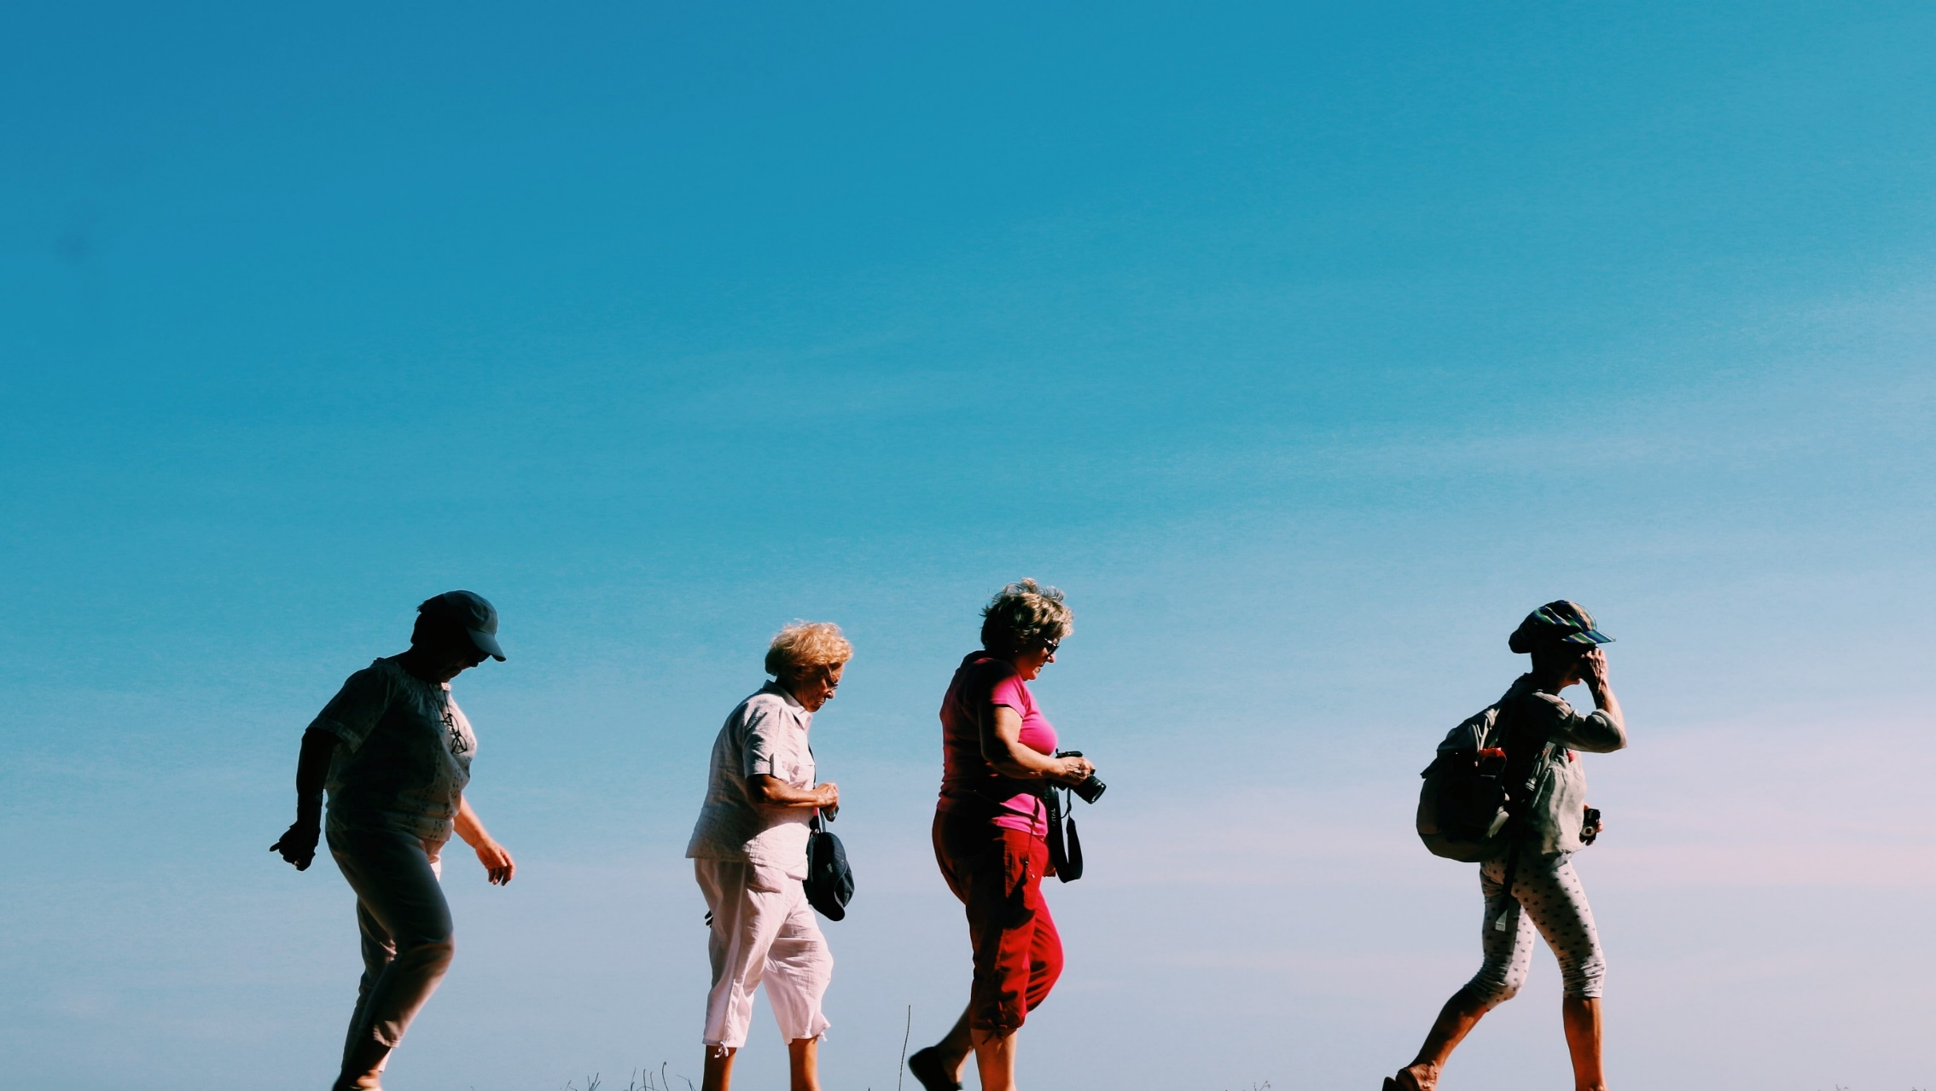
Sociālais atbalsts
palīdz pārvarēt grūtības un tikt galā ar izaicinājumiem
veicina labklājību
piepilda dzīvi ar jēgu
mazina trauksmes un depresijas riskus
paaugstina pašapziņas sajūtu
uzlabo veselību, pagarina dzīvi
sniedz atbildības sajūtu par citiem
Notes:
Social contact is actually extremely important for our physical and mental health. Research shows that social contact and support may help to reduce stress, depression, anxiety and isolation, as well as promote our self-esteem, normality, well-being and quality of life – while a lack of social support has the opposite effect.
The positive effects of good social support can be explained by the fact that such support has a direct impact on our health and wellbeing because it provides us with feelings of predictability, belonging, purpose and security. Another explanation is that social support acts as a buffer against various forms of stress and thus promotes our quality of life and coping mechanisms.

Slide 5
SOCIĀLĀ ATBALSTA TĪKLS
tuvi cilvēki
vienaudži, klasesbiedri
ģimene, radinieki
kolēģi
draugi
kaimiņi
Notes:
„Social support network" refers to a person's connections to other people. These connections are tied by one or more specific types of interdependency, such as values, ideas, economic exchange, friends, kinship, dislike, conflict, trade, sexual relations.
A social support network is made up of friends, family and peers. Social support is different from a support group, which is generally a structured meeting run by a lay leader or mental health professional. Although both support groups and support networks can play an important role in times of stress, a social support network is something you can develop when you're not under stress. It provides the comfort of knowing that your friends are there for you if you need them.
You don't need to formalize your support network. A coffee break with a friend at work, a quick chat with a neighbor, a phone call to your sibling, a visit to a house of worship or volunteer work are all ways to develop and foster lasting relationships with others.

Slide 6
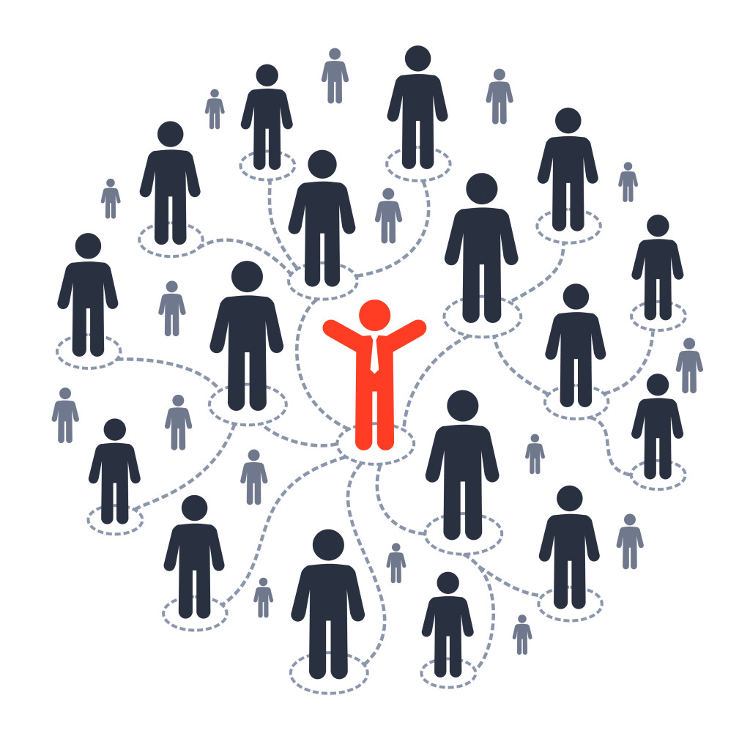
4 SOCIĀLĀ ATBALSTA veidi
Emocionālais atbalsts Pie kā es varu vērsties, kad es jūtos satraukts? | Informatīvais atbalsts Pie kā es varu vērsties pēc padoma, kā risināt problēmas?
Instrumentālais atbalsts Pie kā es varu vērsties pēc praktiskas vai materiālās palīdzības? | Piederību apliecinošs atbalsts Kas ir tie cilvēki, ar ko es varu labi pavadīt laiku un jūsties brīvi?
Katrs no Jūsu sociālā tīkla dalībniekiem, visticamāk, nodrošinās dažāda veida sociālo atbalstu
Notes:
Do you receive different kinds of aid or support from different members of your social network?
For instance, in times of crisis, you might find yourself going to a partner for support and to close friend to have fun and take your mind off things.
'Support' may be a more complex construct than it seems. In fact, research has shown that there are four different types of supportive relationships (Argyle, 1992) and that each benefits our well-being in different ways.
Emotional support refers to the care, appreciation, comfort, love, acceptance, and empathy others offer us. Imagine two friends expressing their feelings over a cup of tea.
Informational support refers to the advice, guidance, and problem-solving we receive from others. Picture a relative giving you advice on the ins and outs of the property market.
Instrumental support refers to the practical help, assistance, and material aid we receive from others. Imagine your child or grandchild driving you to a doctor.
Companionship support refers to those individuals we can have fun with. Picture a fun games night with friends, a dinner party, or maybe even a little road trip.
An important misconception is that each member of our social networks needs to provide all of these types of support. This is not true.
Although an individual may be capable of providing more than one type of support we do not need to expect this from our entire network. One person may provide great emotional support, another may be a great companion. We can rely on different people for different kinds of support and that's okay.

Slide 7
sociālā atbalsta tīkla pamati
Uzturiet regulārus kontaktus
Dāviniet labo
Cenšaties nekonkurēt
Esiet labs klausītājs
Nevajag pārcensties
Novērtējiet draugus un tuviniekus
Dod un ņem pretī !
Notes:
A successful relationship is a two-way street that requires your active participation. Here are some suggestions for nurturing your relationships:
Stay in touch. Answering phone calls, returning emails and reciprocating invitations let people know you care.
Don't compete. Be happy instead of jealous when your friends succeed.
Be a good listener. Listen when your friends are speaking. Find out what's important to them.
Don't overdo it. Be careful not to overwhelm friends and family with phone calls and emails. Save those high-demand times for when you really need them.
Appreciate your friends and family. Take time to say thank you and express how important they are to you.
Give back. Be available for family and friends when they need support.

Slide 8
sociālā atbalsta tīkla stiprināšana
Brīvprātīgais darbs
Pievienoties fizisko aktivitāšu grupai (nūjošana u.c.)
Piedalīties grāmatu vai galda spēļu klubā
Pašpalīdzības un atbalsta grupas
Māksla un amatniecība
Kulinārijas kursi

Slide 9
Diskusjas jautājumi:
Kāpēc cilvēkiem vajadzīgs atbalsts?
Kāda veida sociālo atbalstu Jūs saņēmat savā dzīvē?
Kas var palīdzēt sociālā atbalsta tīkla uzlabošanai?

Slide 10
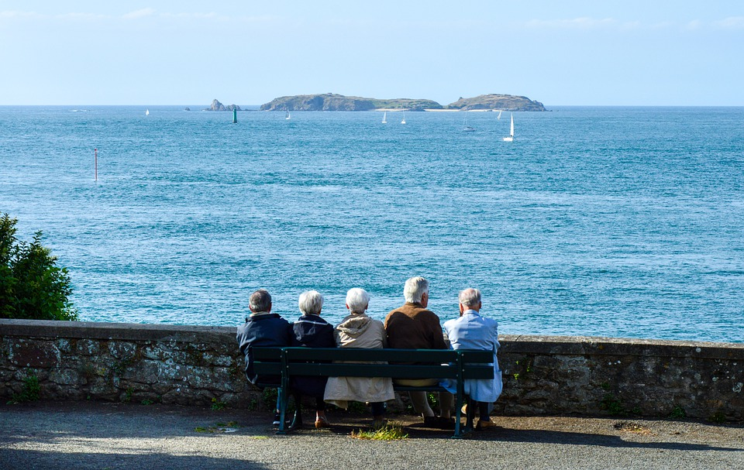
Paldies par uzmanību!
Ko nevaram katrs atsevišķi, varam kopā!

